Slide 1

Gretta Grettas
Team 8: Güzin Duygu Yılmaz, M. Yarkın Ergin, Ghanashyam Khanal, Plamen Kamenov
A quick look at pollutants and temperature since the lockdown
https://github.com/ yilmazduygu/gretta-grettas
Notes:
Hi all, we are the Gretta Grettas.

Slide 2
Is it chillier?
Observation: After the start of the lockdown procedures throughout the world due to COVID-19, posts showing natural life slowly returning to environments where humans usually frequent, began to crop up on social media. Some people claimed that this is the result of quarantining which results in decline of activities that pollute the environment.
Questions: Did pollutant gasses in the air really decrease because people stayed indoors? What is the relationship between pollution levels and temperature levels, and could the current levels of pollution be used to predict the current degrees of temperature?
Goal: conduct a time series analysis of historical temperature and pollution data to see how levels have changed since the lockdown.
Notes:
We had a friend that even posted a video of his backyard showing that it was snowing in May 9th.

Slide 3
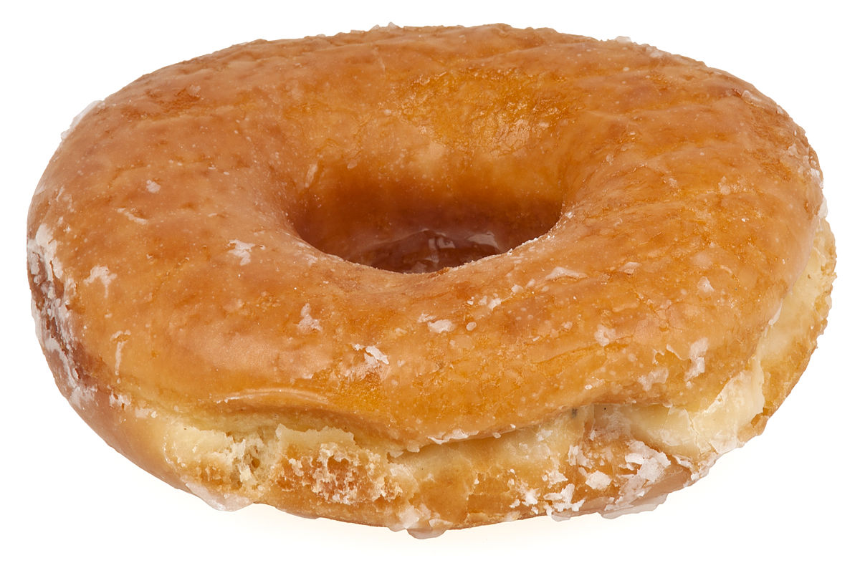
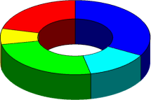
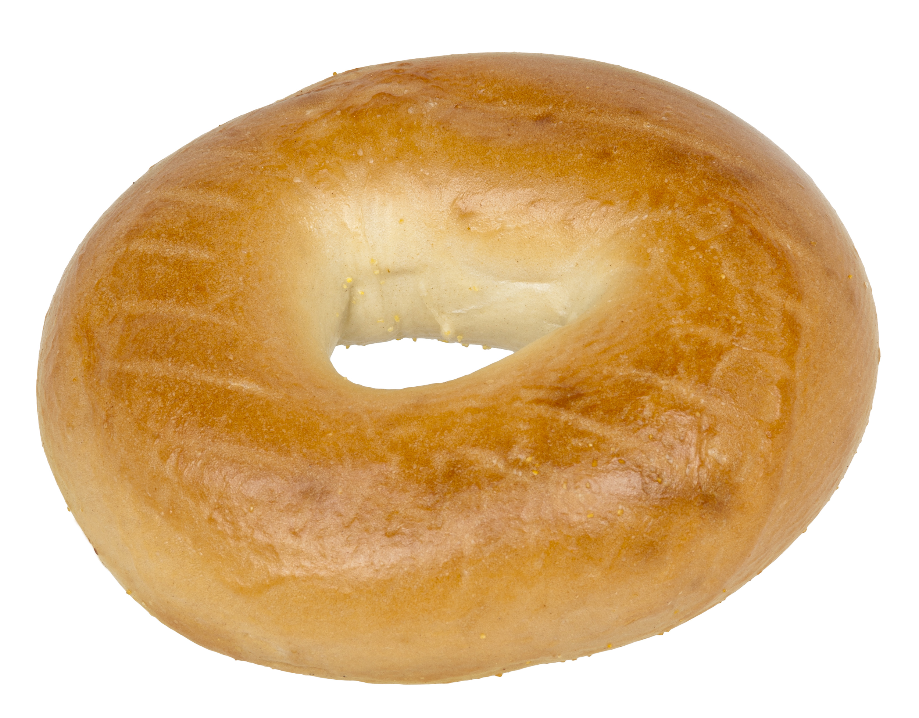
Methods/Packages Used
Kaggle: NOAA using SQL
R packages: tidyr (data manipulation), tseries & fpp2 (time series analysis), ggplot2 (visualization)
Python modules: matplotlib & statsmodels (visualization), sklearn (statistical analysis)
ARIMA and Exponential Smoothing methods to identify the underlying pattern of temperature data and its association with pollutant gasses
Donut?
Bagel?
Pie chart?

Slide 4
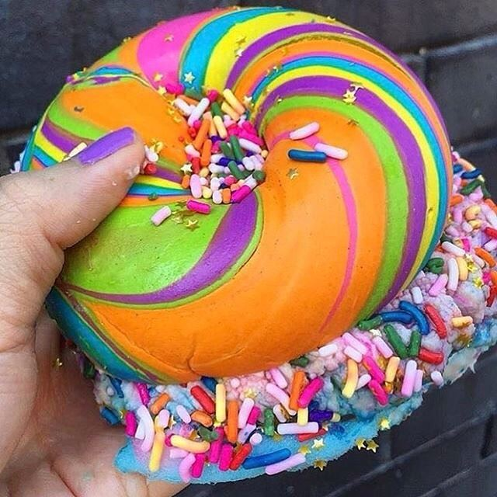
Results and Challenges
Missing data were filled with naive method.
Temperatures doesn’t seem to be all that different
Neither is the pollutant levels
WT?!?!?

Slide 5
Next Steps
Being able to see a representation of this relationship between pollutants and temperature in a world map would be cool, you could see which places’ weather gets affected by pollution more, and then maybe you can come up with interventions to reduce pollution in these targeted areas
Create an app for Android and iOS

Slide 6

Thank You!
TEAM 8: Gretta Grettas
Güzin Duygu Yılmaz
duyguyilmaz@windowslive.com
Rutgers University
Ghanashyam Khanal
ddaniels@snail.com
Rutgers University
M. Yarkın Ergin
m.yarkin.ergin@gmail.com
Rutgers University
Plamen Kamenov
rskeeter@snail.com
Rutgers University
https://github.com/yilmazduygu/gretta-grettas

